Slide 1
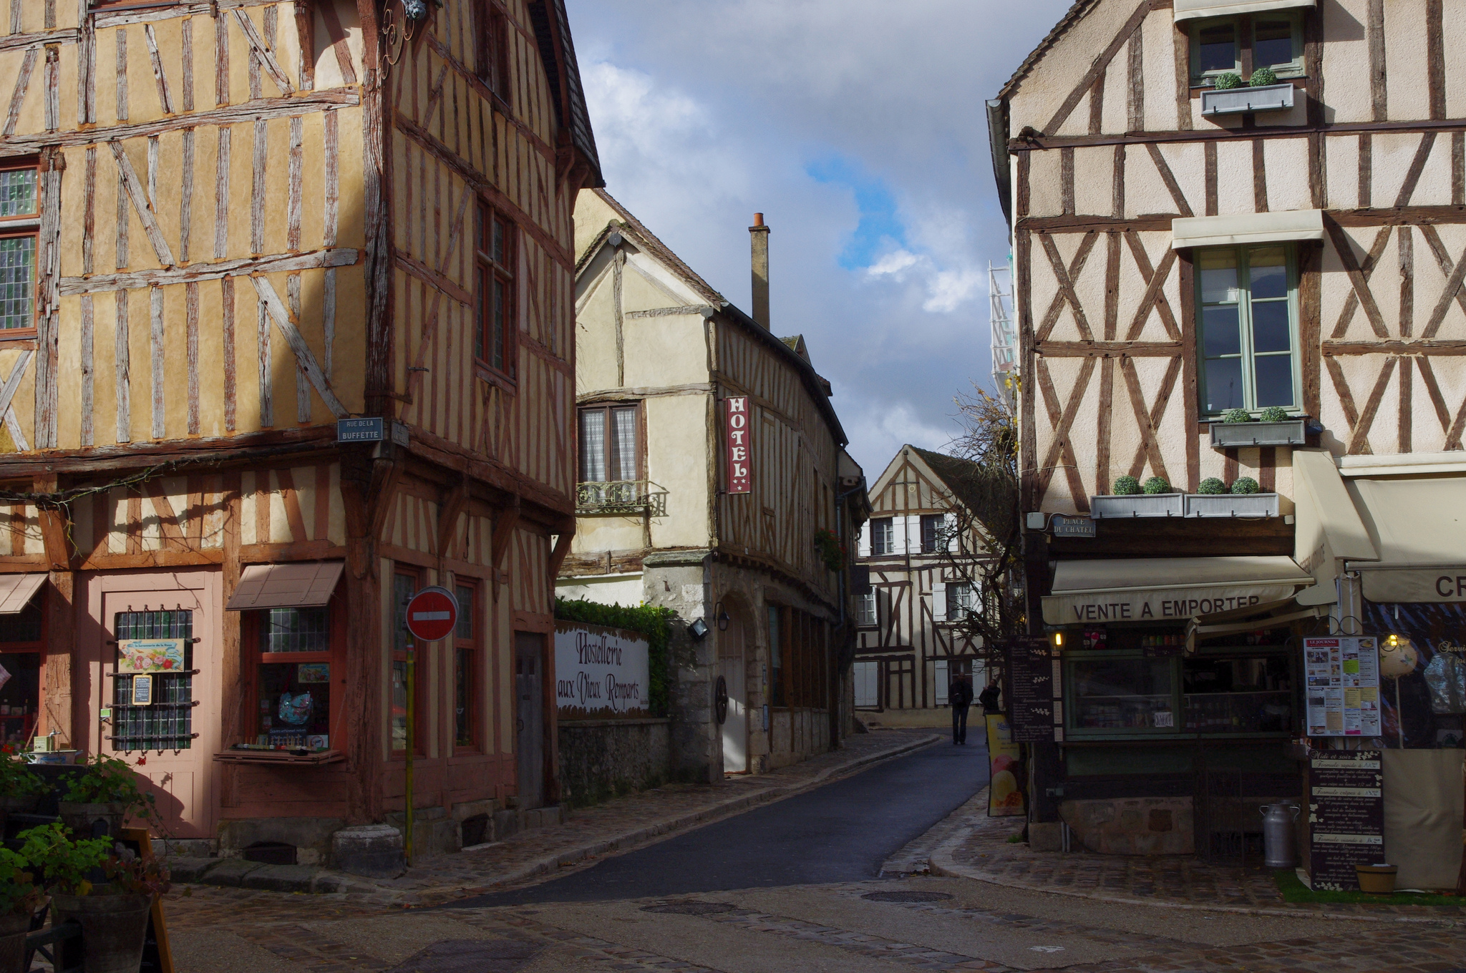
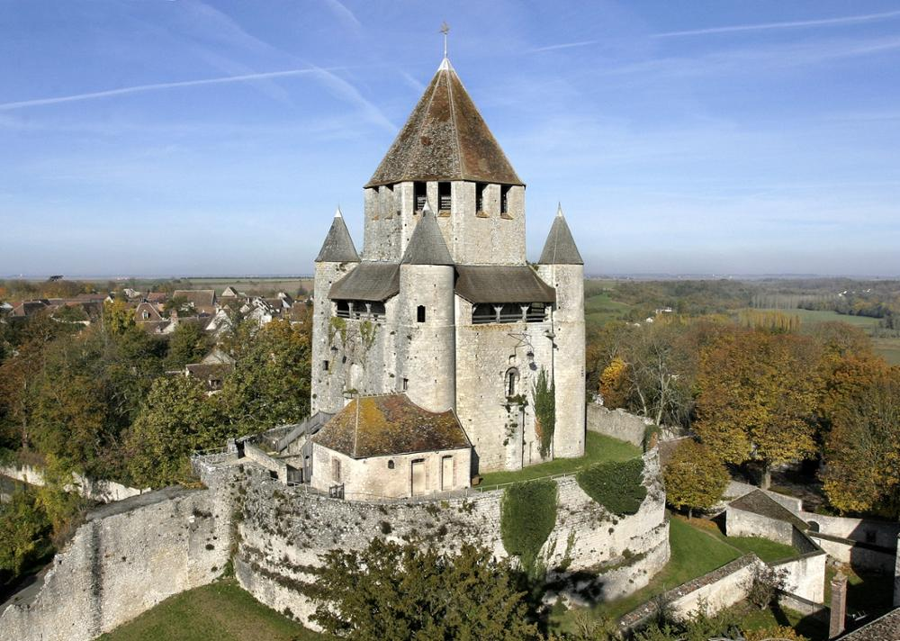
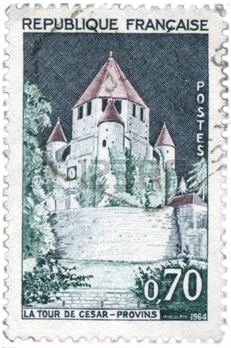
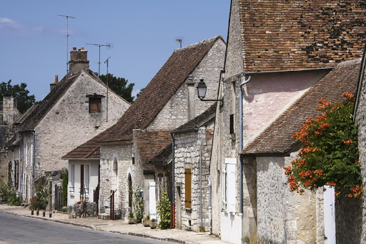
Provins, Town of Medieval Fairs
The formerly wealthy town was built in the former territory of Courts of Champagne, which is in France.
The fortified town was built to host fairs and such activities, especially international trading fairs and the Champagne Fairs in the past.
At one point, Provins had its own coin, the denier provinois (Provins’ penny), which was used throughout medieval Europe.

Slide 2
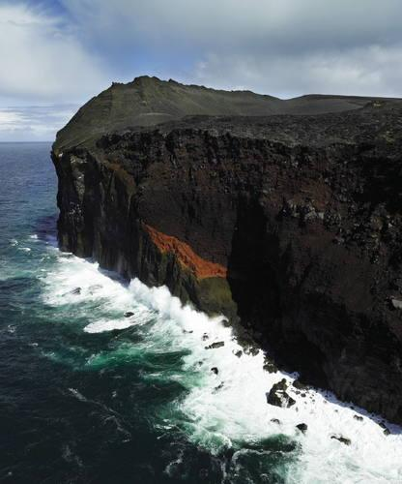
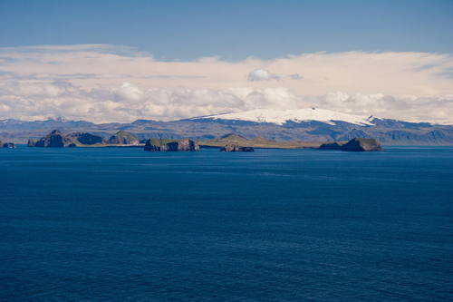
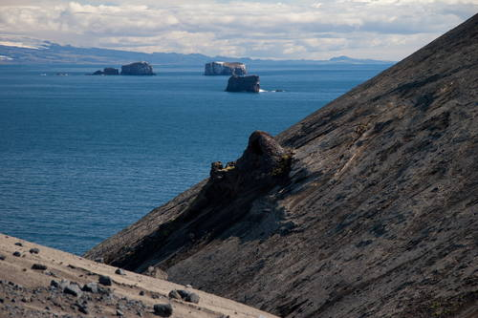
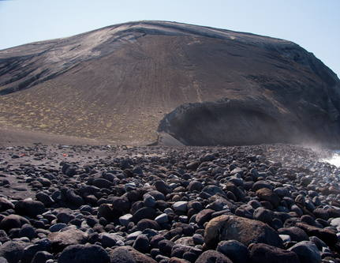
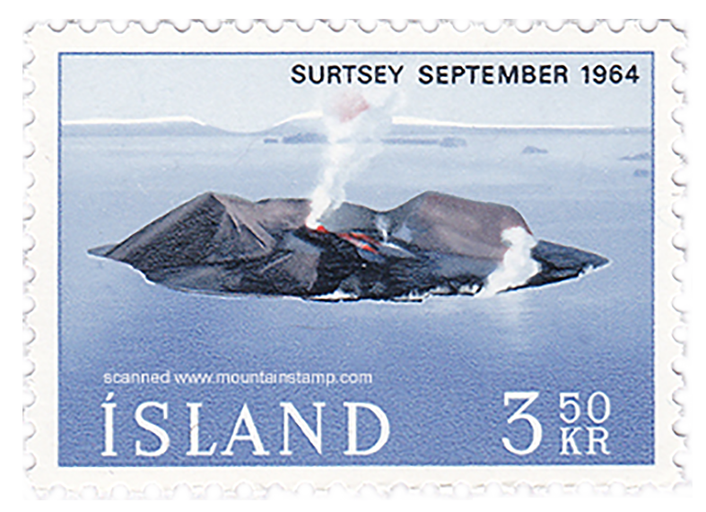
Surtsey
This volcanic island is in Finland, and it is inhabited by various animal and plant life forms.
335 invertebrate species, 71 lichens, 75 bryophytes, 24 fungi, and 89 species of birds, such as whooper swans and common ravens, live on this island.
Since there has been no human interference, this island is home to many animals and plants.

Slide 3
Images Used
Provins, Town of Medieval Fairs:
https://us.123rf.com/450wm/cityanimal/cityanimal1409/cityanimal140900055/31980614-france--circa-1964-a-stamp-printed-by-france-shows-view-of-the-caesar-tower-in-provins-town-of-medie.jpg?ver=6
https://lh5.ggpht.com/fZwvYJxgUKGEYBEDjoK_IQl0f-7pNSOEHudrll3h37AxxyBhpyAcWFEX9w
http://pbdf-dw.ayaline.com/servlets/Web?tache=TraitementImage&idP=796&no=1&w=1000&fxh=712&zimg=middle
https://cdn.theculturetrip.com/wp-content/uploads/2016/08/11273866864_7b16acd229_k.jpg
http://whc.unesco.org/include/tool_image.cfm?id=112972&gallery=site&id_site=873
Surtsey:
http://whc.unesco.org/uploads/thumbs/site_1267_0001-416-500-20090918152859.jpg
http://whc.unesco.org/uploads/thumbs/site_1267_0007-500-333-20140625134128.jpg
http://whc.unesco.org/uploads/thumbs/site_1267_0012-500-333-20140625134131.jpg
https://www.mountainstamp.com/Iceland%20picture/Iceland%201965%20Surtsey%20Volcano%20Mountain%20stamp.jpg
http://whc.unesco.org/uploads/thumbs/site_1267_0003-500-333-20140625134125.jpg

