Slide 1
The Home Insurance Building
By: Rei Kong

Slide 2
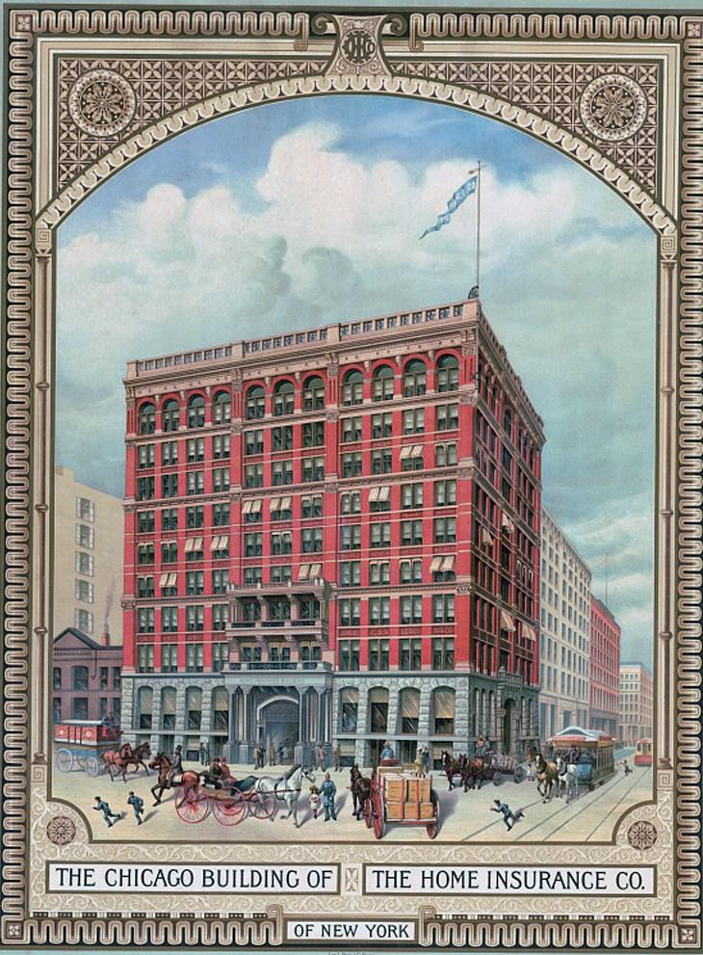
What is the name of your chosen structure?
The name of my building is the Home Insurance Building.

Slide 3
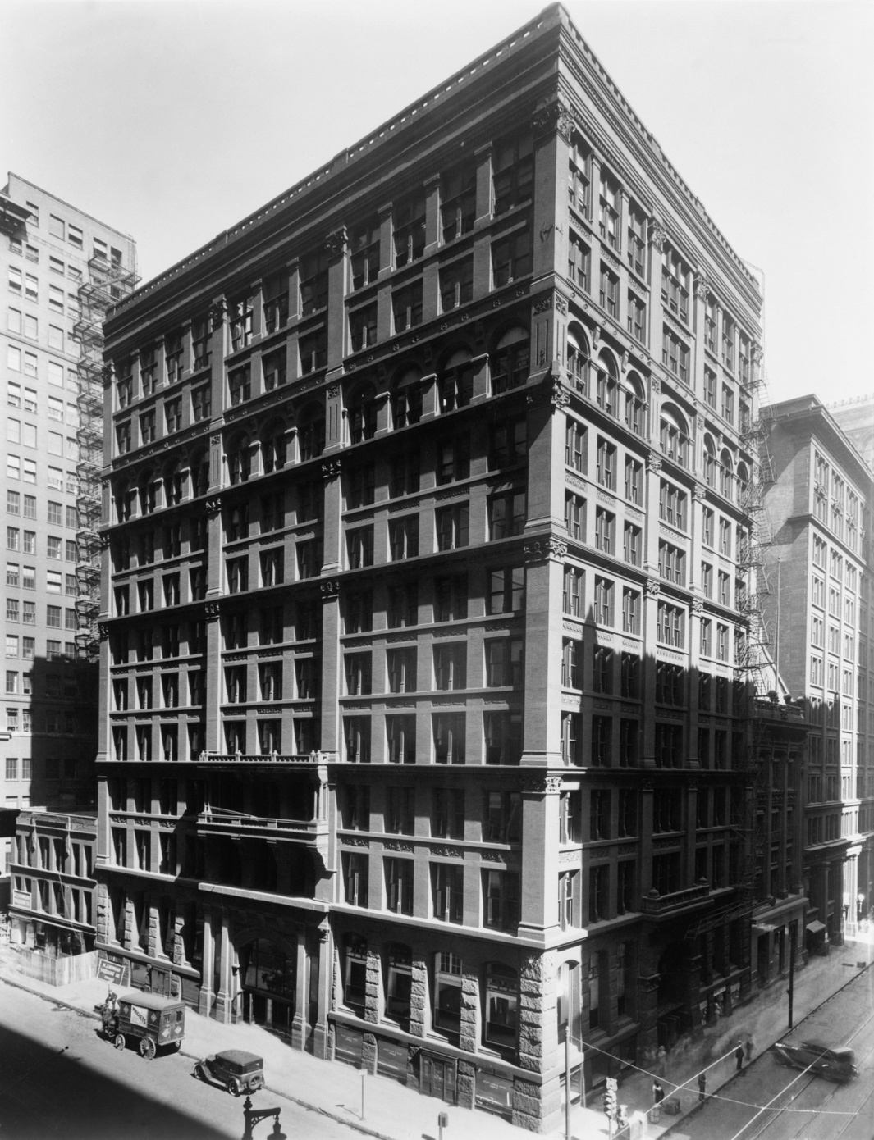
Who designed it?
The architect who designed it is named William Le Baron Jenney, who was also an engineer and mentored some younger architects, such as Daniel Hudson Burnham and Louis Henri Sullivan.

Slide 4
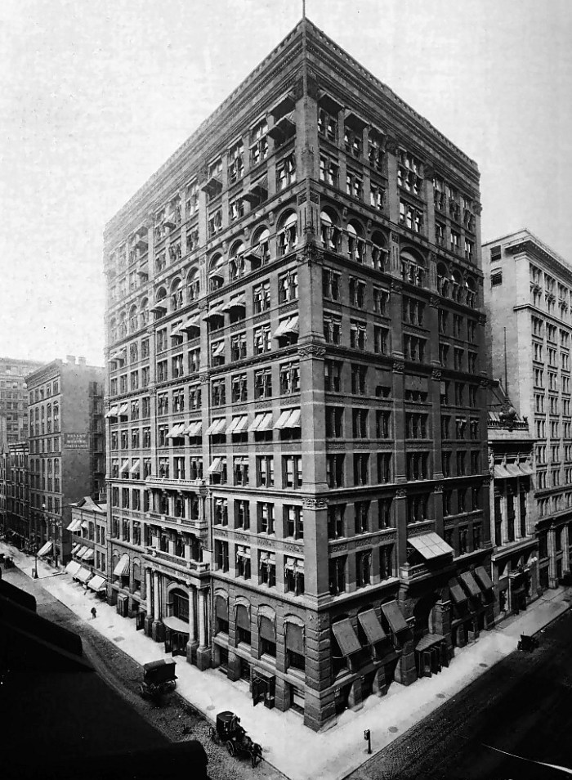
Where is it?
The Home Insurance Building was located in Chicago, Illinois on the corner of Adams and LaSalle Streets. However, it was demolished in 1931 and is not there today.

Slide 5
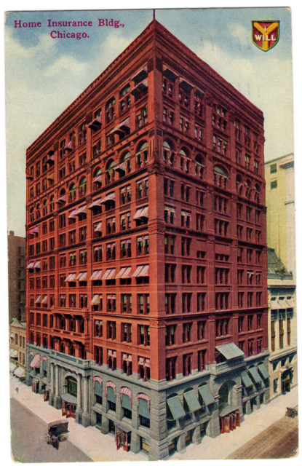
When was it built and how long did it take to build it?
The Home Insurance Building was completed in 1885 and took two years to be built. Later, two more floors were built on top of the existing building in 1890.

Slide 6
Were there any technological advancements that came out of the design of the building?
Initially, buildings were only sturdy and strong enough to be five to six floors tall, which created the problem of not maximizing limited amount of space. Now, because of the Home Insurance Building, buildings can be more than 160 floors high, which is approximately 32 times more than before. More people can be inside the a slightly smaller space as well, since there can be more floors.

Slide 7
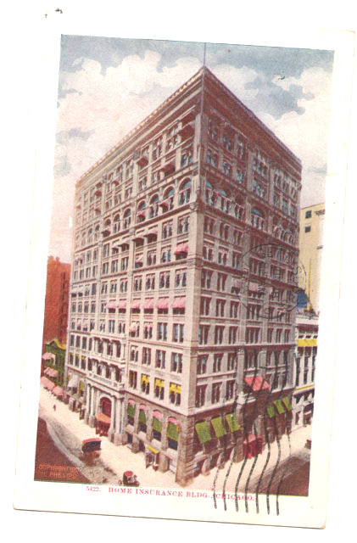
What impact did this structure have (if any) on future architectural designs?
After the Home Insurance Building, skyscrapers were invented and became a popular type of building to design. Before this structure, many buildings were only six or five floors high, and now many more buildings are taller than that.

Slide 8
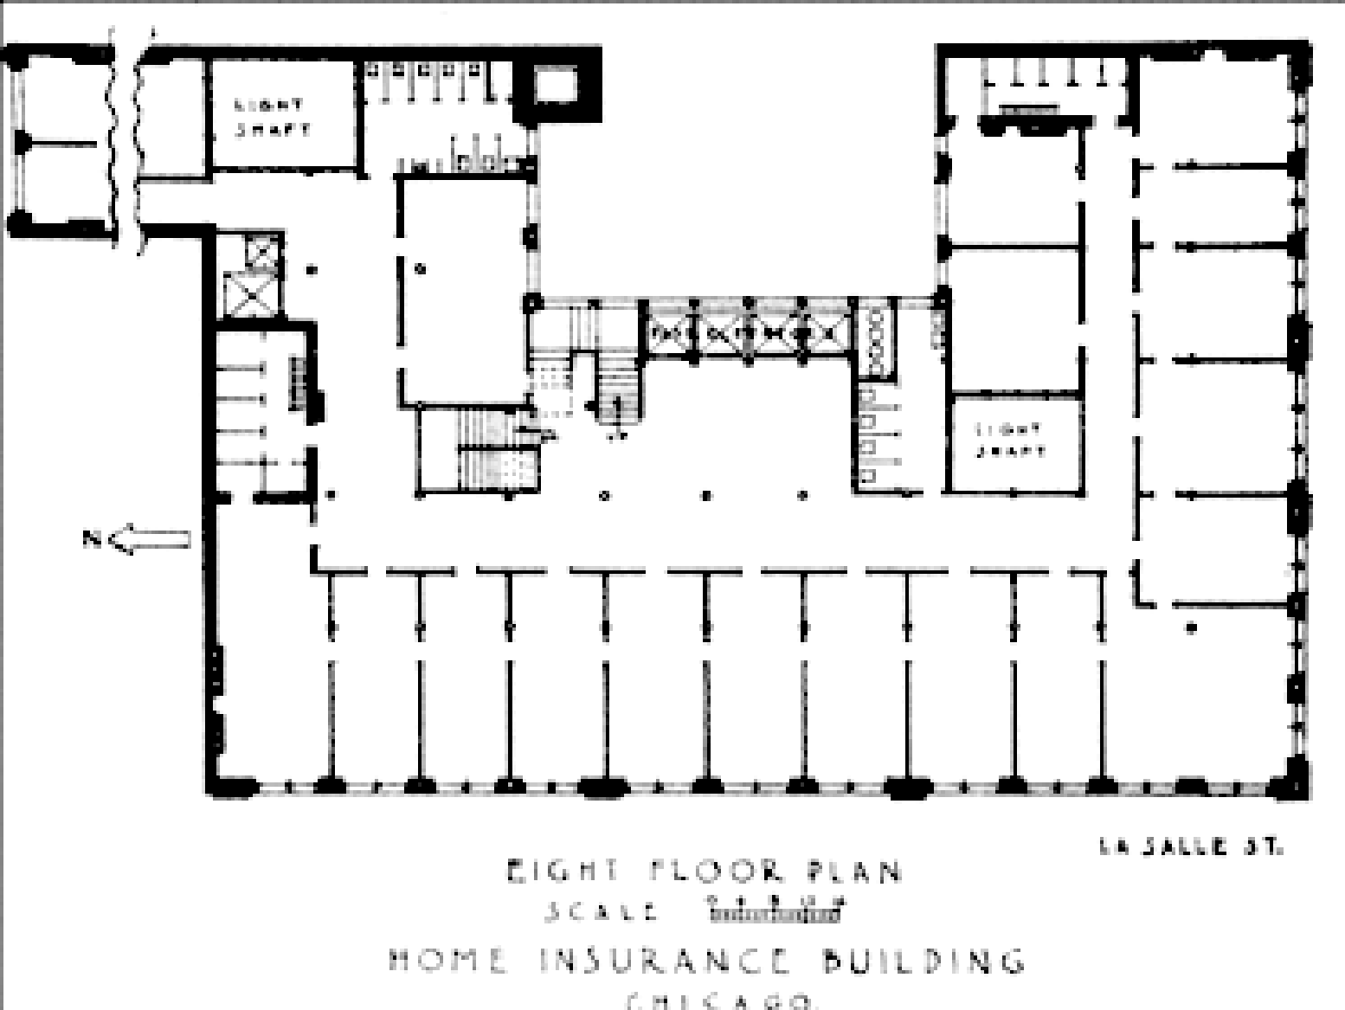
Why did you choose this particular building?
I decided to choose this building because I thought that the very first skyscraper must have been quite influential, since many of the buildings we see today are taller than six floors. The skyscraper is also such a prevalent part in our lives, especially because I live in the city.

Slide 9
Reflection
I felt that this project helped me learn more about architecture, especially skyscrapers in general. I learned more about the creation of the skyscraper and Chicago as the birthplace of the skyscraper as well. Overall, I found this project not too stressful, but it also required a bit of work as well. It was somewhat relaxing doing this project, and I enjoyed it very much.

